Slide 1
Facial Recognition Technology
Humans can easily recognize faces, can computers?
MAC125 Section 5243
Group Project
Elija Agyapong– Code, program, research paper
Joseph – Powerpoint, research paper
Umer Jamil – Powerpoint, research paper
Mikhael Gonzalez – Code, research paper

Slide 2
Security Implementation
Universities, colleges, and schools
Face recognition has the potential to be implemented in school environments for better security and safety
Can quickly recognize and determine who does, and does not belong in the building or area.
Can be further used to identify faculty, staff, students, and unknown persons

Slide 3
Ethical and Moral Issues
Should facial recognition be used?
Face recognition technology is a form of biometrics.
There is concern of privacy issues, breach or misuse of the technology.
Subjects may not even be aware the technology is being used

Slide 4
Issues
Face recognition is not always accurate, and can be affected by many factors such as:
Variations in facial expression
Different angles
Lighting, camera quality, and resolution
Facial hair, hair styles
Accessories (hats, glasses...)

Slide 5
How and why does it work?
Steps:
Data gathering – Provide the program with images or faces
Training – Collect information about unique features of the subject
Face detection & face recognition – Detect that a face is present and determine if a match is found or not

Slide 6
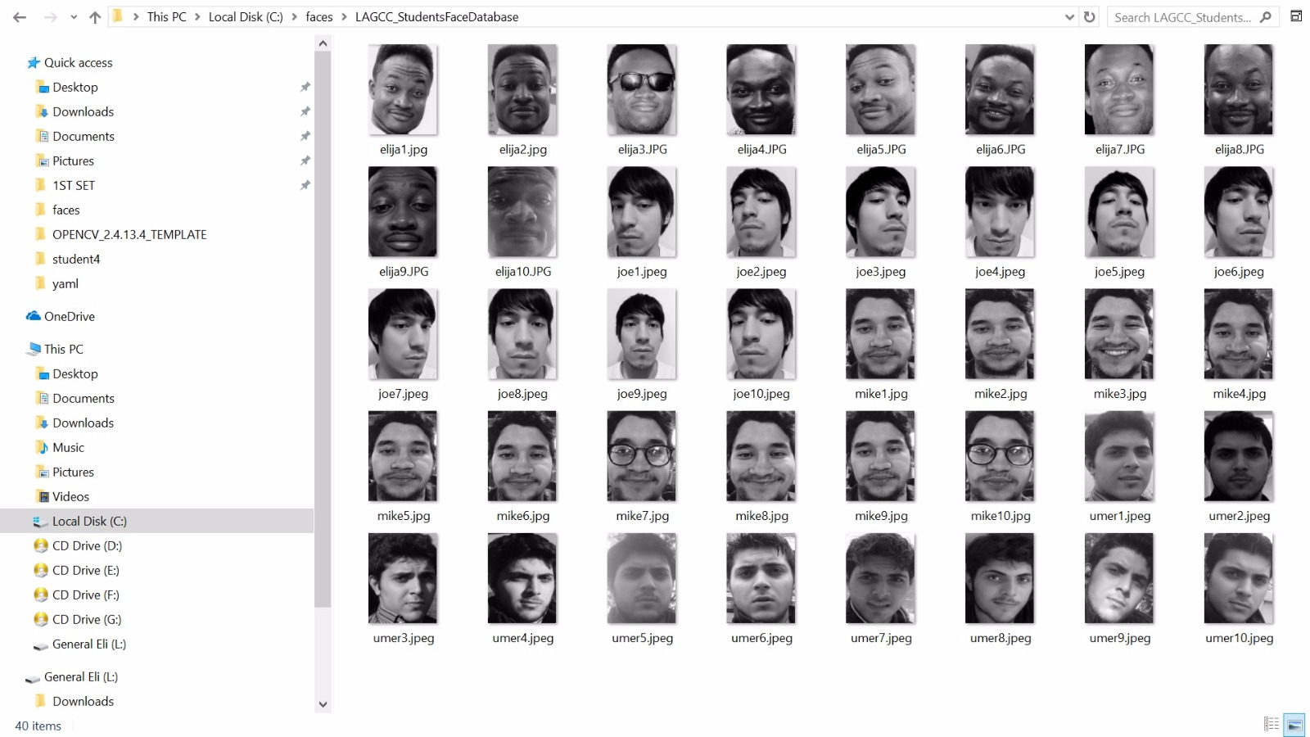

How and why does it work?
Face Database:
A variety of face images are upload and stored in folders
Program then scans and learns unique characteristics and features about these images

Slide 7
How and why does it work?
Algorithms:
2 Common face recognition algorithms –
Eigenfaces Algorithm
Fisherfaces Algorithm

Slide 8
Eigenfaces Algorithm
Uses (Principal Component Analysis) PCA
Not all of the data in an image is actually useful information
PCA finds variations in data (meaningful dimensions) called principal components
Greatly reduces data from high dimension, to low dimension of unique features

Slide 9
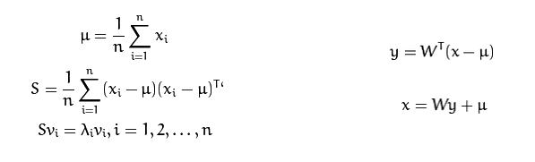
Eigenfaces Algorithm
Source: OpenCV
https://docs.opencv.org/2.4/modules/contrib/doc/facerec/facerec_tutorial.html#algorithmic-description

Slide 10
Fisherfaces Algorithm
Uses Linear Discriminant Analysis (LDA)
Maximizes distance between the means of classes, and minimizes the variance within each class
Also provides dimensionality reduction
Works better for variations in lighting

Slide 11
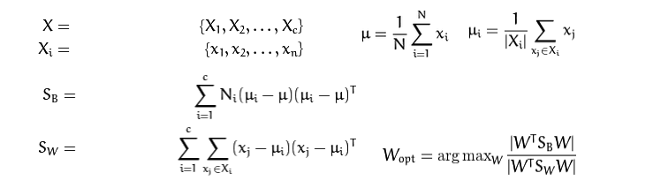
Fisherfaces Algorithm
Source: OpenCV
https://docs.opencv.org/2.4/modules/contrib/doc/facerec/facerec_tutorial.html#id16

Slide 12
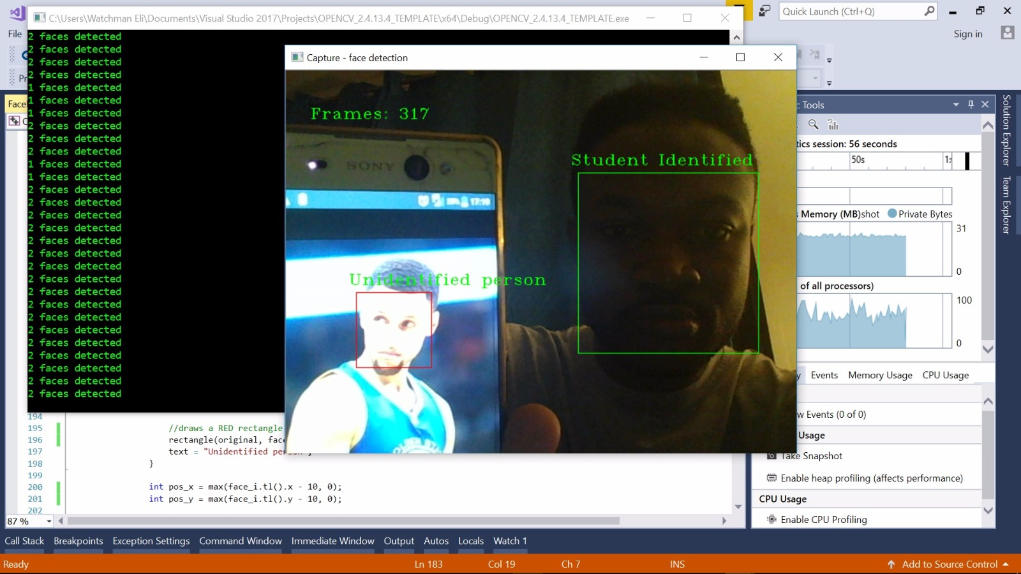
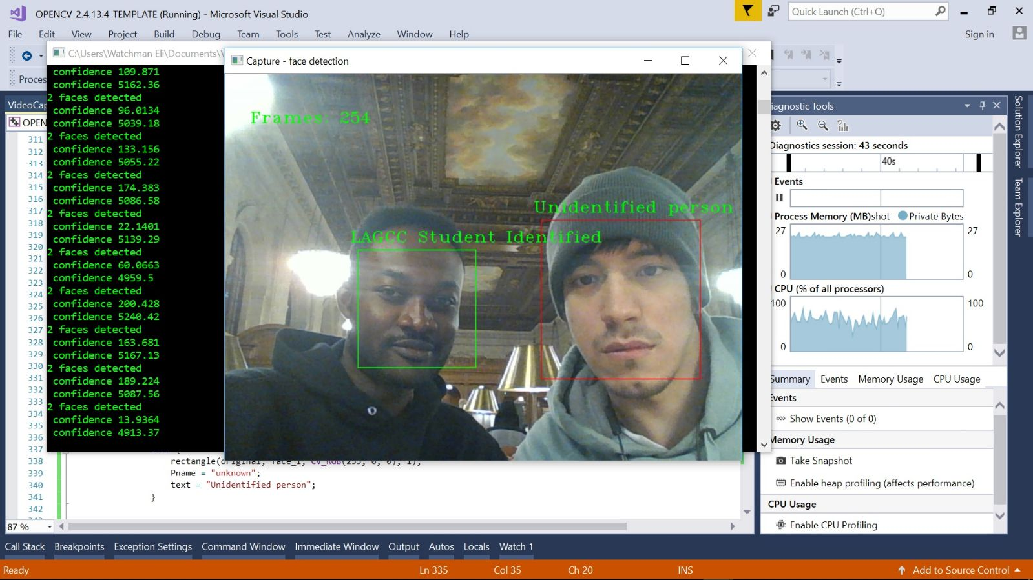
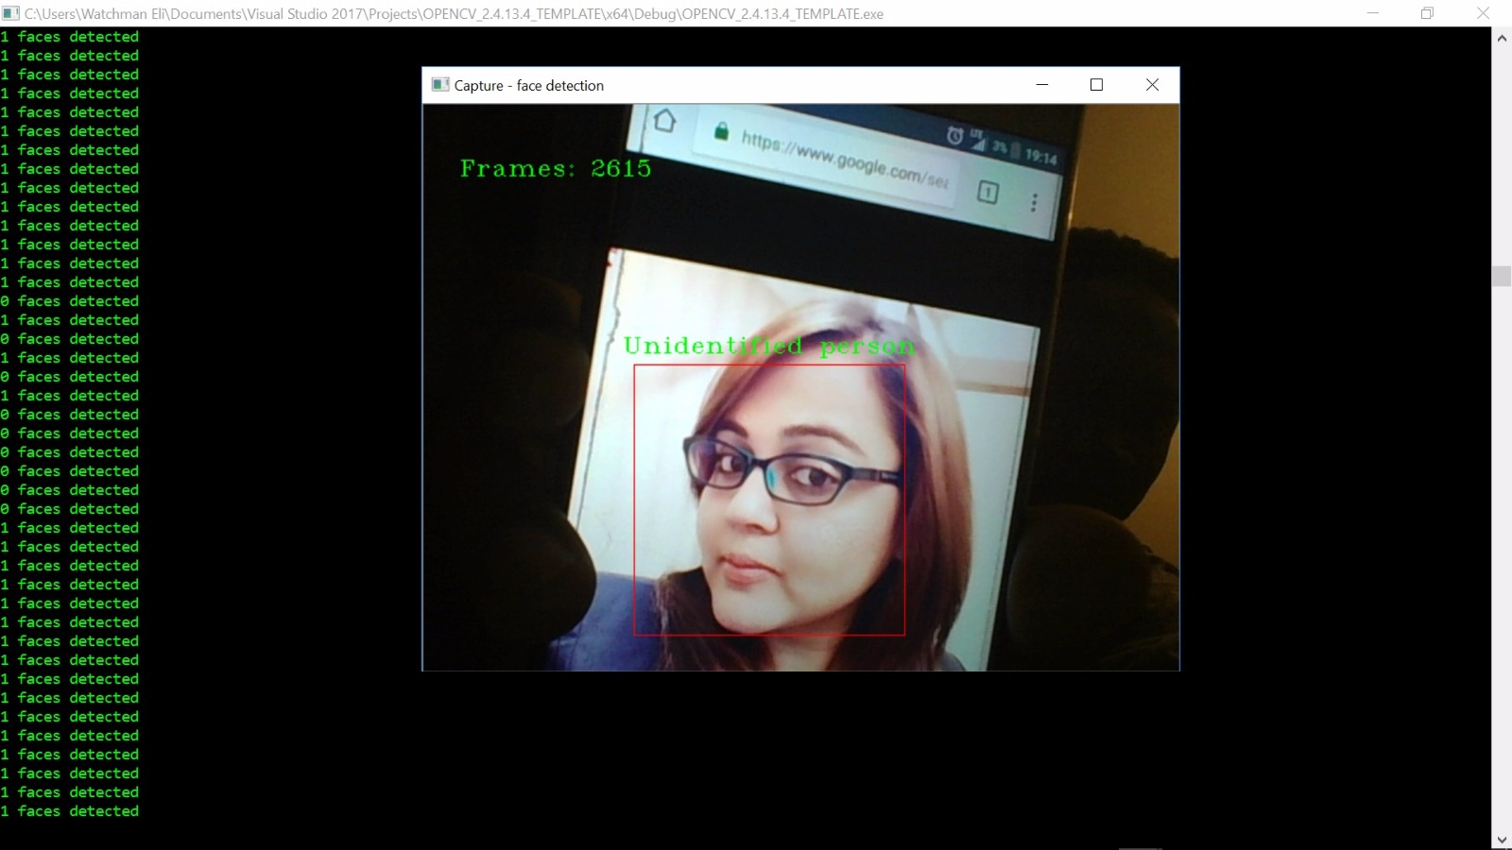
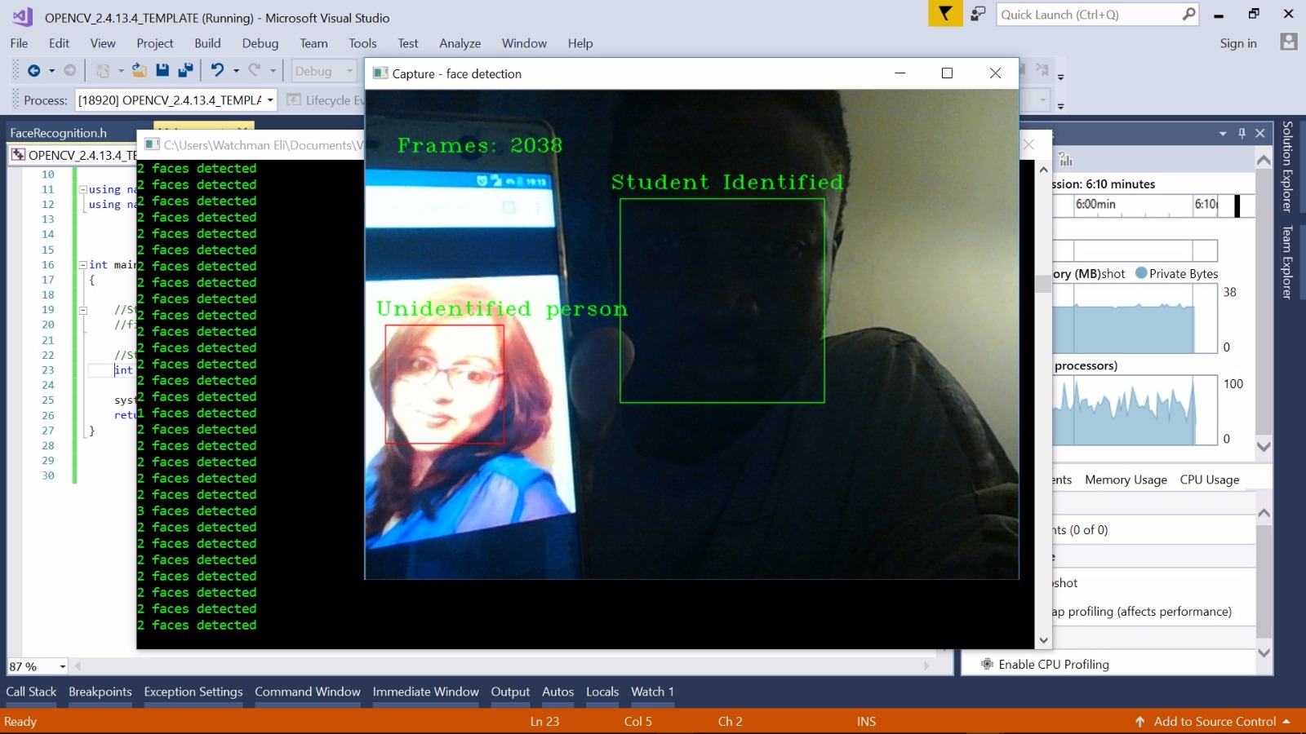
Recognized vs Unrecognized Individuals

Slide 13
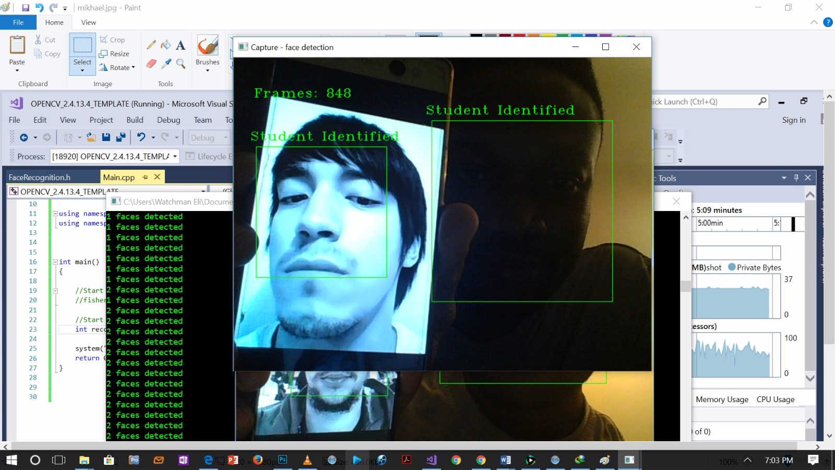
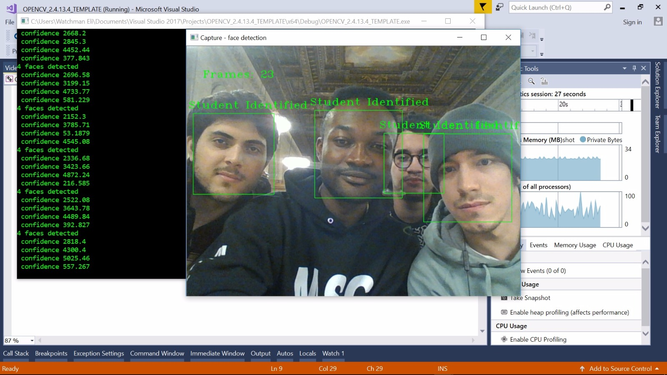
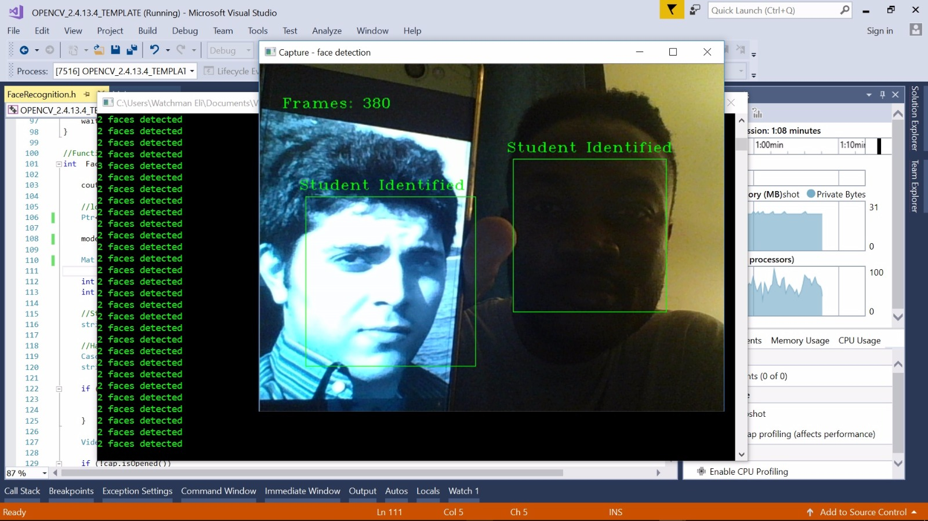
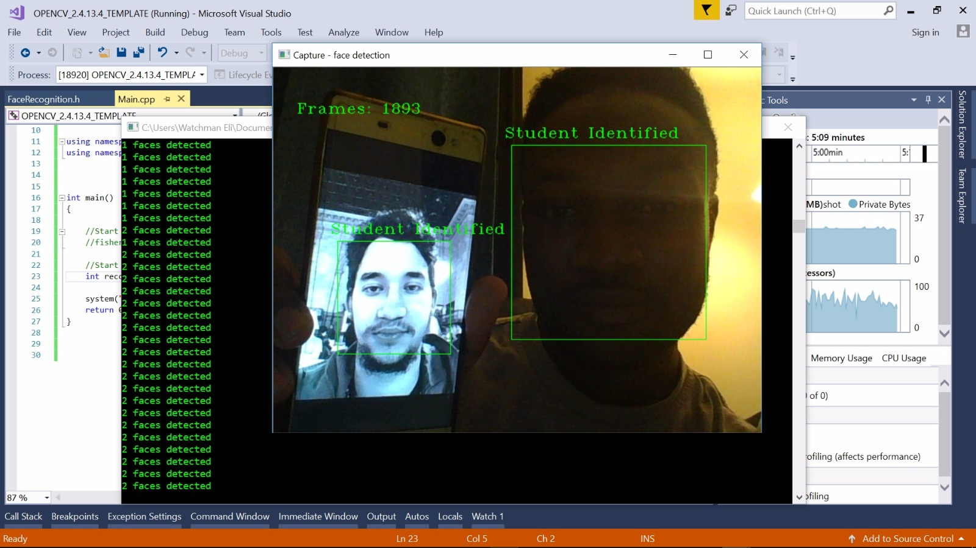
Recognized vs Unrecognized Individuals

